Slide 1


«Програмування та підтримка веб-застосувань»
Львівський національний університет імені Івана Франка
факультет прикладної математики та інформатики
кафедра Інформаційних систем
Core JavaScript
Вовк Олександр Володимирович
vovk@windowslive.com
2017

Slide 2
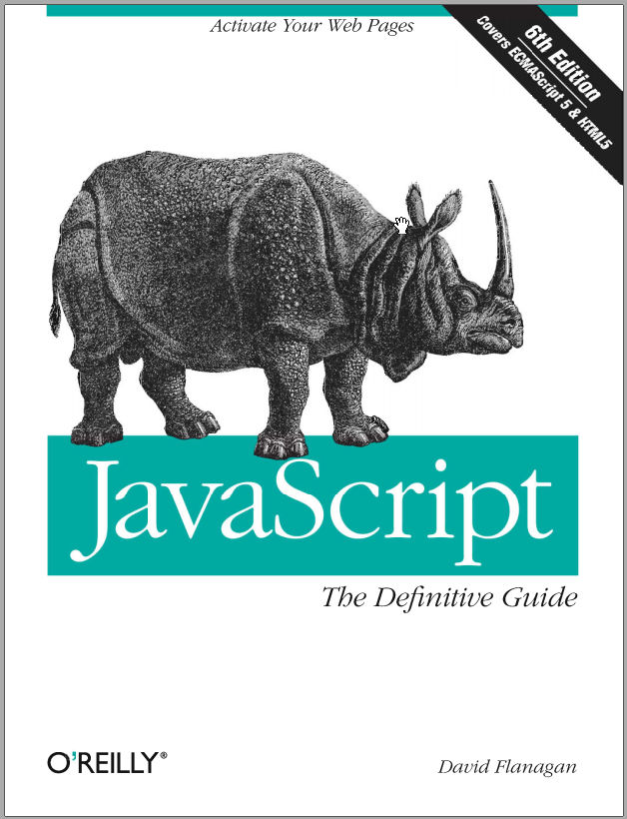
David Flanagan. JavaScript. The Definitive Guide. O'Reilly Media, 2011
JavaScript is the programming language of the Web.
The overwhelming majority of modern websites use JavaScript, and all modern web browsers—on desktops, game consoles, tablets, and smart phones—include JavaScript interpreters, making JavaScript the most ubiquitous programming language in history.
JavaScript is part of the triad of technologies that all Web developers must learn:
HTML to specify the content of web pages,
CSS to specify the presentation of web pages,
JavaScript to specify the behavior of web pages.

Slide 3
JavaScript is a
high-level,
dynamic,
untyped interpreted programming language
well-suited to object-oriented and functional programming styles.
JavaScript derives:
its syntax from Java,
its first-class functions from Scheme,
its prototype based inheritance from Self.

Slide 4
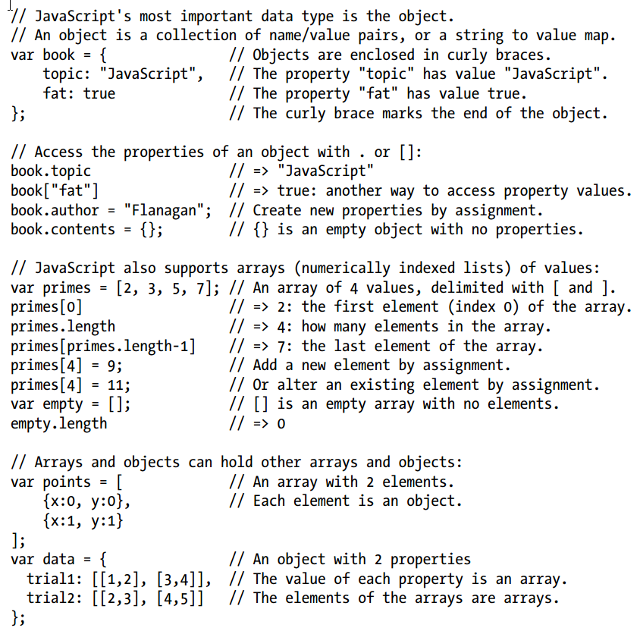

Slide 5
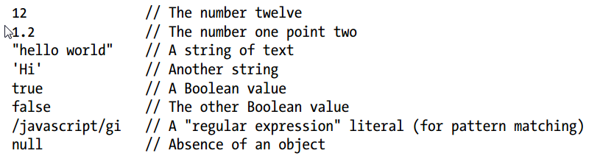

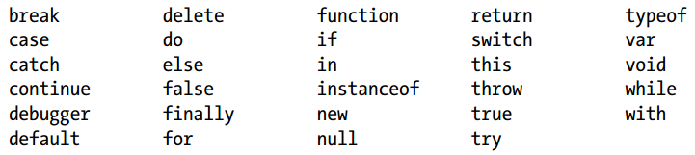
Lexical Structure
JavaScript is a case-sensitive language (but HTML is not case-sensitive! tags and attribute names can be typed in any case in HTML, in JavaScript they typically must be all lowercase)
Some computer hardware and software can not display or input the full set of Unicode characters. To support programmers using this older technology, JavaScript defines special sequences of six ASCII characters to represent any 16-bit Unicode codepoint: "café" === "caf\u00e9" // => true.
A literal is a data value that appears directly in a program:
A JavaScript identifier must begin with a letter, an underscore (_), or a dollar sign ($). JavaScript allows identifiers to contain letters and digits from the entire Unicode character set
JavaScript reserves a number of identifiers as the keywords of the language itself:

Slide 6
Types, Values, and Variables
JavaScript represents numbers using the 64-bit floating-point format which means it can represent numbers as large as ±1.7976931348623157×10^308 and as small as ±5×10^−324 аnd integers between −2^53 and 2^53, inclusive. Certain operations in JavaScript (such as array indexing and the bitwise operators) are performed with 32-bit integers.
Any JavaScript value can be converted to a boolean value. These values convert to, false: undefined, null, 0, -0, NaN, "" // the empty string
null is a language keyword that evaluates to a special value that is usually used to indicate the absence of a value. Using the typeof operator on null returns the string “object”, indicating that null can be thought of as a special object value that indicates “no object”
The undefined value represents a deeper kind of absence. It is the value of variables that have not been initialized and the value you get when you query the value of an object property or array element that does not exist. The undefined value is also returned by functions that have no return value, and the value of function parameters for which no argument is supplied. undefined is a predefined global variable (not a language keyword like null) that is initialized to the undefined value.
Despite these differences, null and undefined both indicate an absence of value and can often be used interchangeably. The equality operator == considers them to be equal. (Use the strict equality operator === to distinguish them.)
You might consider undefined to represent a system-level, unexpected, or error-like absence of value and null to represent program-level, normal, or expected absence of value.

Slide 7
Types, Values, and Variables: The Global Object
The global object is a regular JavaScript object that serves a very important purpose: the properties of this object are the globally defined symbols that are available to a JavaScript program.
When the JavaScript interpreter starts (or whenever a web browser loads a new page), it creates a new global object and gives it an initial set of properties that define:
global properties like undefined, Infinity, and NaN
global functions like isNaN(), parseInt(), and eval()
constructor functions like Date(), RegExp(), String(), Object(), and Array()
global objects like Math and JSON
In client-side JavaScript, the Window object serves as the global object for all JavaScript code contained in the browser window it represents. This global Window object has a self-referential window property that can be used instead of this to refer to the global object. The Window object defines the core global properties, but it also defines quite a few other globals that are specific to web browsers and client-side JavaScript.

Slide 8


Types, Values, and Variables: Wrapper Objects:
Strings are not objects, so why do they have properties? Whenever you try to refer to a property of a string s, JavaScript converts the string value to an object as if by calling new String(s).
Numbers and booleans have methods for the same reason that strings do: a temporary object is created using the Number() or Boolean() constructor, and the method is resolved using that temporary object.
When you run this code, the value of t is undefined. The second line of code creates a temporary String object, sets its len property to 4, and then discards that object. The third line creates a new String object from the original (unmodified) string value and then tries to read the len property. This property does not exist, and the expression evaluates to undefined.
Strings, numbers, and boolean values behave like objects when you try to read the value of a property (or method) from them. But if you attempt to set the value of a property, that attempt is silently ignored: the change is made on a temporary object and does not persist.
Note that it is possible (but almost never necessary or useful) to create wrapper objects

Slide 9

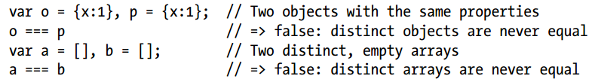
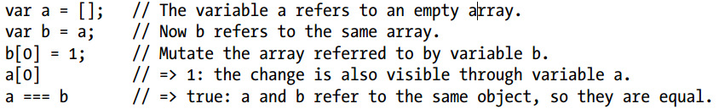
Immutable Primitive Values and Mutable Object References:
There is a fundamental difference between primitive values (undefined,null, booleans, numbers, and strings) and objects (including arrays and functions). Primitives are immutable: there is no way to change (or “mutate”) a primitive value. This is obvious for numbers and booleans. It is not so obvious for strings, however. Since strings are like arrays of characters, you might expect to be able to alter the character at any specified index. In fact, JavaScript does not allow this, and all string methods that appear to return a modified string are, in fact, returning a new string value. For example:
Objects are different than primitives. First, they are mutable—their values can change. Second, Objects are not compared by value: two objects are not equal even if they have the same properties and values.
Objects are sometimes called reference types to distinguish them from JavaScript’s primitive types. Objects are compared by reference: two object values are the same if and only if they refer to the same underlying object

Slide 10
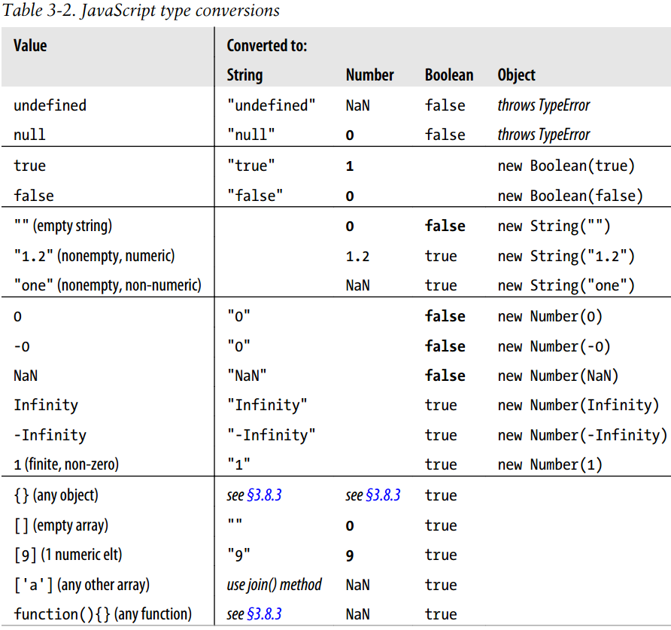
Type Conversions:
JavaScript is very flexible about the types of values it requires

Slide 11
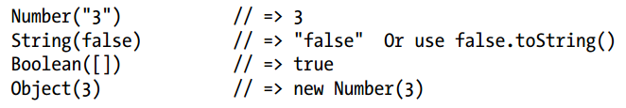

Conversions and Equality:
Strict equality operator === that does not perform conversions when testing for equality
Keep in mind that convertibility of one value to another does not imply equality of those two values. If undefined is used where a boolean value is expected, for example, it will convert to false. But this does not mean that undefined == false. For det. see 4.9.1.
The if statement converts undefined to false, but the == operator never attempts to convert its operands to booleans.
The simplest way to perform an explicit type conversion is to use the following functions:
Certain JavaScript operators perform implicit type conversions, and are sometimes used for the purposes of type conversion. If one operand of the + operator is a string, it converts the other one to a string. The unary + operator converts its operand to a number. And the unary ! operator converts its operand to a boolean and negates it.
Object-to-boolean conversions are trivial: all objects (including arrays and functions) convert to true. This is so even for wrapper objects: new Boolean(false) is an object rather than a primitive value, and so it converts to true.

Slide 12
Object-to-string and object-to-number conversions are performed by invoking a method of the object to be converted (toString(), valueOf()). Host objects (defined by web browsers, for example) can convert to numbers and strings according to their own algorithms.
To convert an object to a string, JavaScript takes these steps:
If the object has a toString() method, JavaScript calls it. If it returns a primitive value, JavaScript converts that value to a string (if it is not already a string) and returns the result of that conversion.
If the object has no toString() method, or if that method does not return a primitive value, then JavaScript looks for a valueOf() method. If the method exists, JavaScript calls it. If the return value is a primitive, JavaScript converts that value to a string (if it is not already) and returns the converted value.
Otherwise, JavaScript cannot obtain a primitive value from either toString() or valueOf(), so it throws a TypeError.
To convert an object to a number, JavaScript does the same thing, but it tries the valueOf() method first:
If the object has a valueOf() method that returns a primitive value, JavaScript converts (if necessary) that primitive value to a number and returns the result.
Otherwise, if the object has a toString() method that returns a primitive value, JavaScript converts and returns the value.
Otherwise, JavaScript throws a TypeError

Slide 13
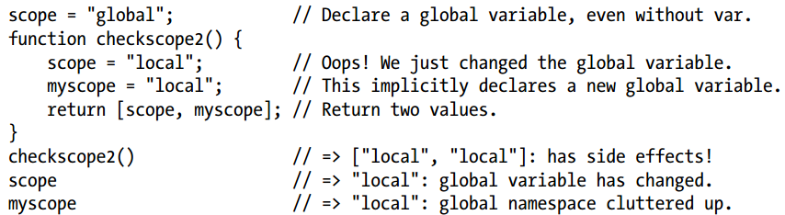
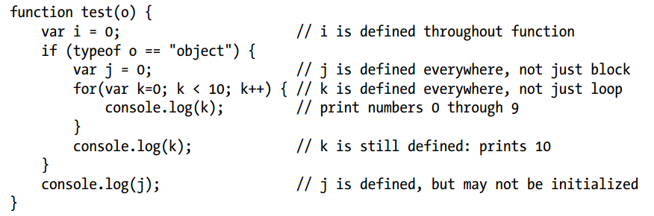
Repeated and Omitted Declarations
In non-strict mode, if you assign a value to an undeclared variable, JavaScript actually creates that variable as a property of the global object, and it works much like a properly declared global variable.
This is a bad habit and a source of bugs, however, and you should always declare your variables with var .
Variable Scope:
In some C-like programming languages, each block of code within curly braces has its own scope, and variables are not visible outside of the block in which they are declared.
Instead, JavaScript uses function scope: variables are visible within the function in which they are defined and within any functions that are nested within that function.

Slide 14
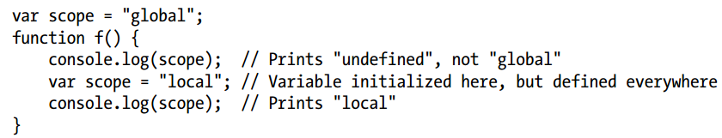
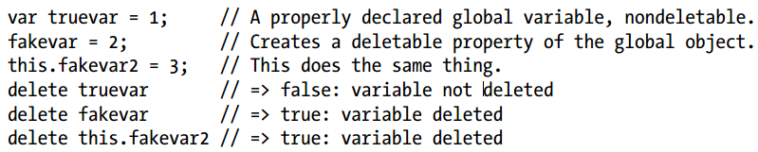
Variable Scope:
JavaScript’s function scope means that all variables declared within a function are visible throughout the body of the function. Curiously, this means that variables are even visible before they are declared. This feature of JavaScript is informally known as hoisting: JavaScript code behaves as if all variable declarations in a function (but not any associated assignments) are “hoisted” to the top of the function.
If you use var to declare the variable, the property that is created is nonconfigurable, which means that it cannot be deleted with the delete operator.
There is no such requirement for local variables, but you can imagine local variables as the properties of an object associated with each function invocation.
ECMAScript 5 specification calls it a “declarative environment record.”
JavaScript allows us to refer to the global object with the this keyword, but it does not give us any way to refer to the object in which local variables are stored.

Slide 15
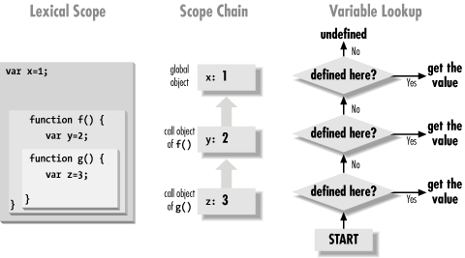
The Scope Chain
When that function is invoked, it creates a new object to store its local variables, and adds that new object to the stored scope chain to create a new, longer, chain that represents the scope for that function invocation.
This becomes more interesting for nested functions because each time the outer function is called, the inner function is defined again. Since the scope chain differs on each invocation of the outer function, the inner function will be subtly different each time it is defined—the code of the inner function will be identical on each invocation of the outer function, but the scope chain associated with that code will be different.

Slide 16

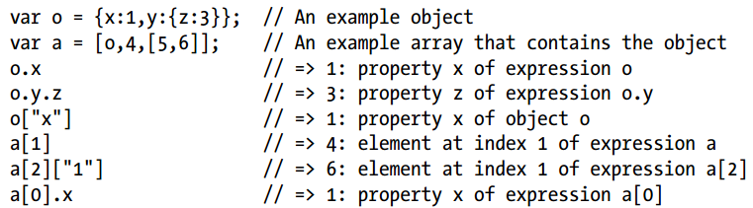
Property Access Expressions
JavaScript defines two syntaxes for property access:
An object creation:
JavaScript first creates a new empty object, just like the one created by the object initializer {}.
It invokes the specified function with the specified arguments, passing the new object as the value of the this keyword.
The function can then use this to initialize the properties of the newly created object.
Functions written for use as constructors do not return a value, and the value of the object creation expression is the newly created and initialized object.
If a constructor does return an object value, that value becomes the value of the object creation expression and the newly created object is discarded

Slide 17
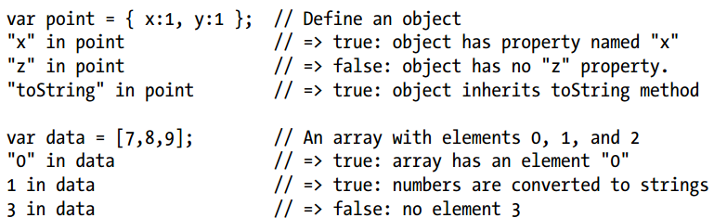
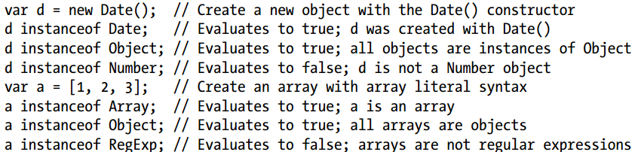
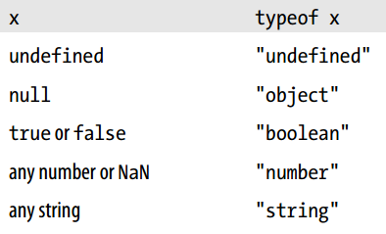
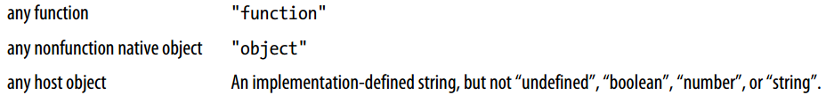
The in Operator
The instanceof Operator
The typeof Operator

Slide 18

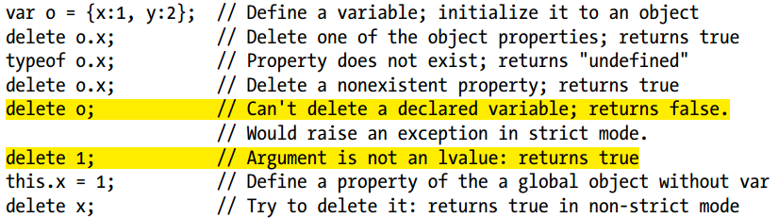
The delete Operator
Note that a deleted property or array element is not merely set to the undefined value. When a property is deleted, the property ceases to exist.
Not all properties can be deleted, however: some built-in core and client-side properties are immune from deletion, and user-defined variables declared with the var statement cannot be deleted.
Functions defined with the function statement and declared function parameters cannot be deleted either.

Slide 19

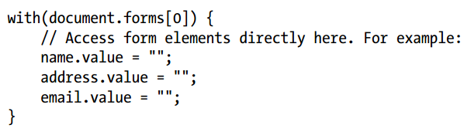
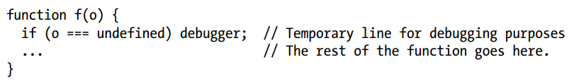
Statements
The ECMAScript specification does not specify the order in which the for/in loop enumerates the properties of an object
copy the names of all object properties into an array
The with statement is used to temporarily extend the scope chain
this statement acts like a breakpoint: execution of JavaScript code stops and you can use the debugger to print variables’ values, examine the call stack, and so on

Slide 20

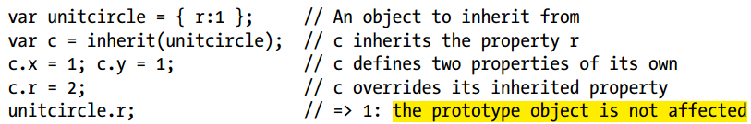
Objects in details
Every JavaScript object has a second JavaScript object (or null, but this is rare) associated with it. This second object is known as a prototype, and the first object inherits properties from the prototype.
Object.prototype is one of the rare objects that has no prototype: it does not inherit any properties.
linked series of prototype objects is known as a prototype chain
ECMAScript 5 defines a method, Object.create(), that creates a new object, using its first argument as the prototype of that object
You can pass null to create a new object that does not have a prototype, but if you do this, the newly created object will not inherit anything, not even basic methods like toString().
The delete operator only deletes own properties, not inherited ones. (To delete an inherited property, you must delete it from the prototype object in which it is defined. Doing this affects every object that inherits from that prototype)

Slide 21
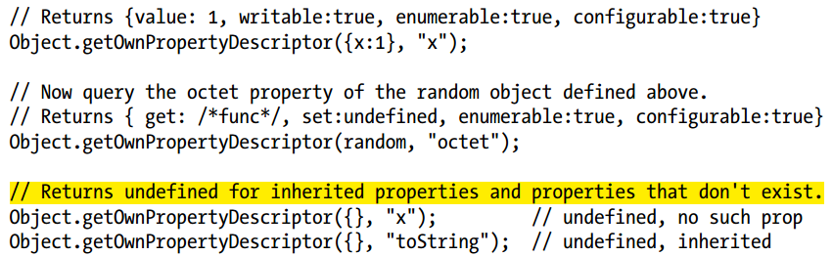
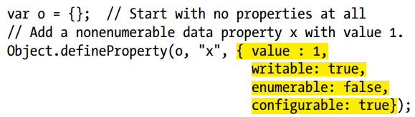

Property Attributes
In addition to a name and value, properties have attributes that specify whether they can be written, enumerated, and configured. In ECMAScript 3, there is no way to set these attributes: all properties created by ECMAScript 3 programs are writable, enumerable, and configurable, and there is no way to change this.
Get attribute properties:
Set attribute properties:
Serializing Objects:
If a property value cannot be serialized, that property is simply omitted from the stringified output.

Slide 22





Arrays in details
Different elements of the same array may be of different types
JavaScript arrays are zero-based and use 32-bit indexes: the index of the first element is 0, and the highest possible index is 4294967294 (232−2)
Sparse Arrays:
When you omit value in an array literal, you are not creating a sparse array:
Array Length:
In ECMAScript 5, you can make the length property of an array read-only with Object.defineProperty()
Array-Like Objects, in client-side JavaScript, a number of DOM methods, such as document.getElementsByTagName().
Strings behave like read-only arrays. Array methods like push(), sort(), reverse(), and splice() modify an array in place and do not work on strings. Attempting to modify a string using an array method does not, however, cause an error: it simply fails silently!

Slide 23
Functions
In addition to the arguments, each invocation has another value—the invocation context—that is the value of the this keyword. Note that this is a keyword, not a variable or property name. JavaScript syntax does not allow you to assign a value to this.
Since functions are objects, you can set properties on them, and even invoke methods on them
JavaScript function definitions can be nested within other functions, and they have access to any variables that are in scope where they are defined. Nested functions do not inherit the this value of their caller
Function declaration statements are “hoisted” to the top of the enclosing script or the enclosing function, so that functions declared in this way may be invoked from code that appears before they are defined. This is not true for functions defined as expressions, however: in order to invoke a function, you must be able to refer to it, and you can’t refer to a function defined as an expression until it is assigned to a variable. Variable declarations are hoisted (but assignments to those variables are not hoisted, so functions defined with expressions cannot be invoked before they are defined.
If a function does not contain a return statement, it simply executes each statement in the function body and returns the undefined value to the caller
function declaration statements are not true statements, and are allowed as top-level statements. They can appear in global code, or within other functions, but they cannot appear inside of loops, conditionals, or try/catch/finally or with statements. Note that this restriction applies only to functions declared as statements. Function definition expressions may appear anywhere in your JavaScript code.
When methods return objects, you can use the return value of one method invocation as part of a subsequent invocation. (jQuery library)

Slide 24

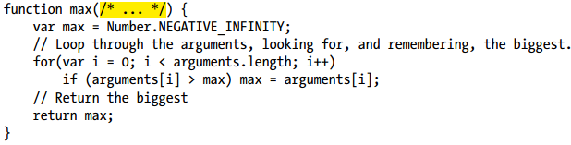
Functions
Constructor Invocation:
Note that the new object is used as the invocation context even if the constructor invocation looks like a method invocation. That is, in the expression new o.m(), o is not used as the invocation context.
Constructor functions do not normally use the return keyword. They typically initialize the new object and then return implicitly when they reach the end of their body. In this case, the new object is the value of the constructor invocation expression. If, however, a constructor explicitly used the return statement to return an object, then that object becomes the value of the invocation expression. If the constructor uses return with no value, or if it returns a primitive value, that return value is ignored and the new object is used as the value of the invocation.
JavaScript functions are objects and like all JavaScript objects, they have methods. Two of these methods, call() and apply(), invoke the function indirectly.
When a function is invoked with fewer arguments than declared parameters, the additional parameters are set to the undefined value. Within the body of a function, the identifier arguments refers to the Arguments object for that invocation.
The numbered elements of the Arguments object and the parameter names are like two different names for the same variable.

Slide 25

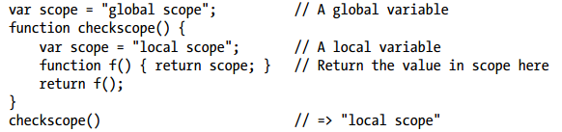
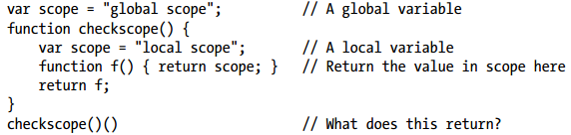
The Arguments object defines callee and caller properties, callee property refers to the currently running function, caller is a nonstandard but commonly implemented property that refers to the function that called this one.
Closures:
JavaScript uses lexical scoping. This means that functions are executed using the variable scope that was in effect when they were defined, not the variable scope that is in effect when they are invoked. In order to implement lexical scoping, the internal state of a JavaScript function object must include not only the code of the function but also a reference to the current scope chain.
Remember the fundamental rule of lexical scoping: JavaScript functions are executed using the scope chain that was in effect when they were defined. The nested function f() was defined under a scope chain in which the variable scope was bound to the value “local scope”. That binding is still in effect when f is executed, wherever it is executed from. So the last line of code above returns “local scope”, not “global cope”

Slide 26
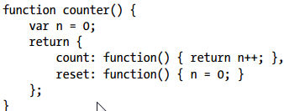
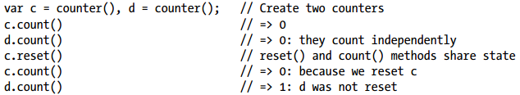
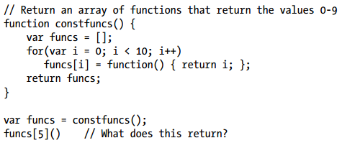
Implementing Closures:
The closures are all defined within the same invocation of the function, so they share access to the variable i. When constfuncs() returns, the value of the variable i is 10, and all 10 closures share this value. Therefore, all the functions in the returned array of functions return the same value:
Another thing to remember when writing closures is that this is a JavaScript keyword, not a variable. As discussed earlier, every function invocation has a this value, and a closure cannot access the this value of its outer function unless the outer function has saved that value into a variable

Slide 27
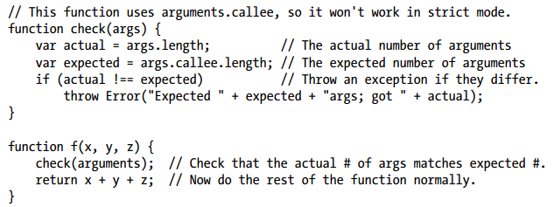


Length property
Within the body of a function, arguments.length specifies the number of arguments that were passed to the function. The length property of a function itself is read-only property returns the arity of the function—the number of parameters it declares in its parameter list, which is usually the number of arguments that the function expects.
The bind() Method (ECMAScript 5)
When you invoke the bind() method on a function f and pass an object o, the method returns a new function. Invoking the new function (as a function) invokes the original function f as a method of o
bind() method performs partial application (currying in functional programming): any arguments you pass to bind() after the first are bound along with the this value.

